Slide 1
Introduction to Visualization

Slide 2
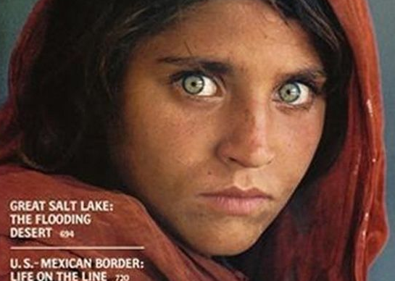

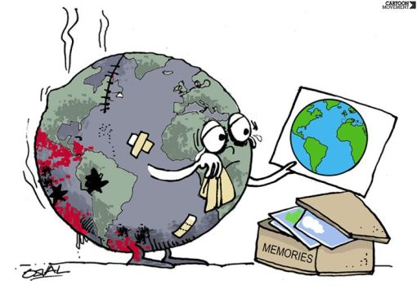
A picture is worth a thousand words
Visualization is the representation of information in a graphical form
Photographs
Street Art
Comics
Steve McCurry
Banksy
Notes:
There are many forms of visualizations such as photographs, street art, comics, etc which can convey information

Slide 3
A picture is worth a thousand words
Notes:
We usually hear that a picture is worth a thousand words

Slide 4
A picture is worth a thousand words rows
Year | Profits ($)
1990 | 138.1
1991 | 140.2
1992 | 137.8
1993 | 142.1
1994 | 144.5
1995 | 143.2
1996 | 148.9
1997 | 139.9
1998 | 136.5
1999 | 138.2
2000 | 135.5
2001 | 137.4
2002 | 150.4
2003 | 150.9
2004 | 149.3
2005 | 152.3
2006 | 180.1
2007 | 183.2
2008 | 192.5
2009 | 185.2
Which is the most profitable year?
Notes:
But in our field, a picture is worth a thousand rows. Have the students determine the year with the highest profit. It will take them a minute or so to complete the task.

Slide 5
A picture is worth a thousand words rows
Which is the most profitable year?
Notes:
Here is the same data in a bar chart form. It should take the students no time to figure out that 2008 is the most profitable year. This is the power of visualization, where we can perform a task (determine the most profitable year) very quickly.

Slide 6
The purpose of visualization is insight, not pictures
Ben Shneiderman
Notes:
Don’t just create pretty charts. If you include a chart, make sure there is a purpose for it.

Slide 7
EXAMPLES

Slide 8
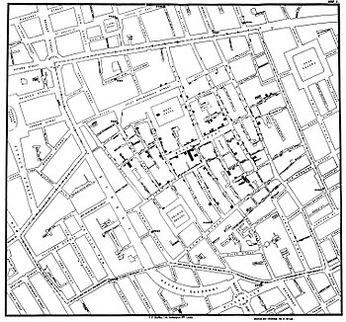
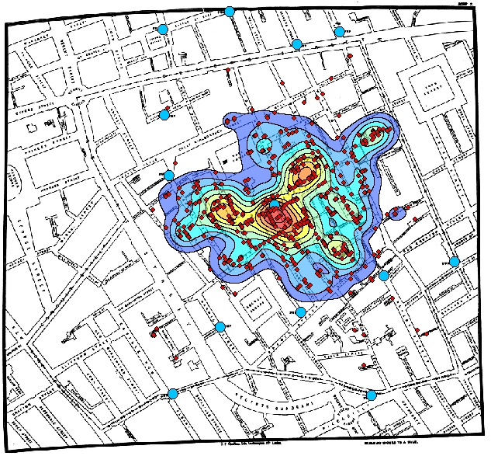
1854 Broad Street Cholera Outbreak
John Snow
Notes:
In 1854 there was a cholera outbreak in London. At the time it was unclear if cholera spread via airborne, water, etc. Dr. John Snow put on a map several bars symbolizing the number of deaths per location. The image on the right is a heat map someone created on top of the map. The red dots indicate locations where people died from cholera. The blue dots indicate water pumps. We can observe that there is a Water pump right in the middle on Broad Street. This was the first indication that cholera could be spread via water. They shut down that water pump and were able to control the outbreak. This visual is one of the early indications of how a good visual can have a big impact.

Slide 9
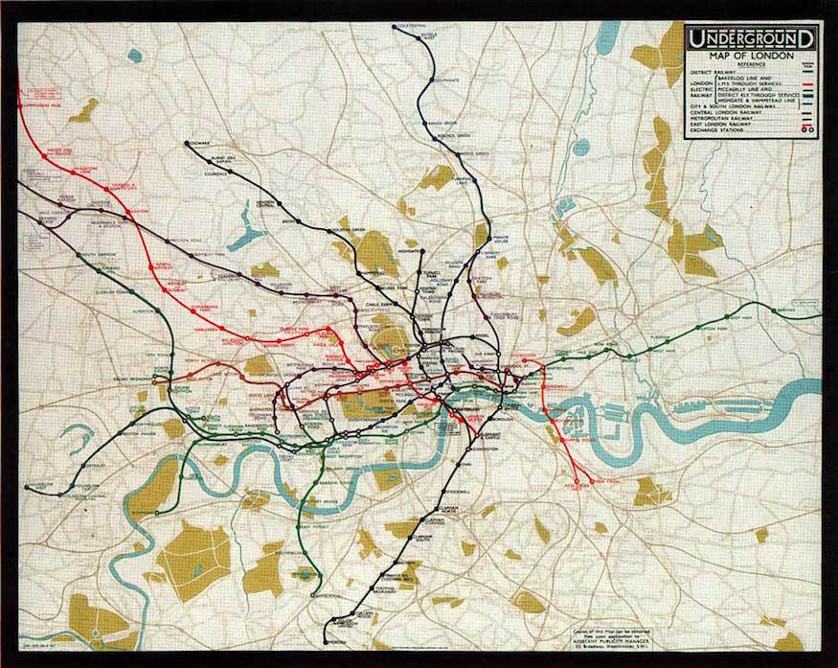
London Tube Map - 1908
Notes:
This is one of the original subway maps of the London Tube. It is hard to figure out how to get from one place to another. It is a very accurate representation of reality, but not very useful.

Slide 10
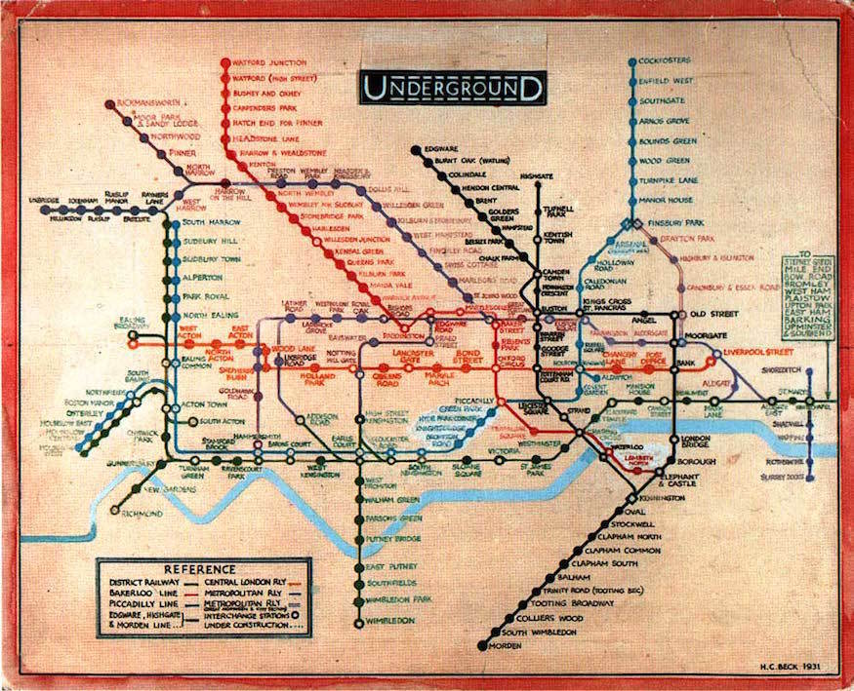
London Tube Map – Harry Beck 1931
Notes:
Harry Beck – an electrical engineer – redesigned the map. The lines are horizontal, vertical and diagonal, and the stations are equally spaced. This is not a very accurate map, but extremely effective. In summary, usefulness is more important than accuracy,

Slide 11
TYPES OF DATA

Slide 12
Types of Data
Qualitative
Ordinal
Nominal
Quantitative
Continuous
Discrete

Slide 13
Qualitative Data
Arise when the observations fall into distinct categories
Eye color: blue, green, brown
Exam results: A, B, C, D, F
Socio-economic status: low, middle, high
Nominal: no natural order (e.g. eye color)
Ordinal: order exists (e.g. exam results, socio-economic status)

Slide 14
Quantitative Data
Arise when the observations are counts or measurements
Age
Weight
Temperature
Discrete: measurements only take certain values (e.g. age)
Continuous: measurements can take on any value within a range (e.g. weight, temperature)

Slide 15
Binning
Continuous data can be converted to discrete or qualitative data
“Low” Weight < 100 lbs
“Medium” 100 lbs ≤ Weight < 200 lbs
“High” 200 lbs ≤ Weight
Notes:
We can convert continuous data into discrete by using bins

Slide 16
TYPES OF CHARTS

Slide 17
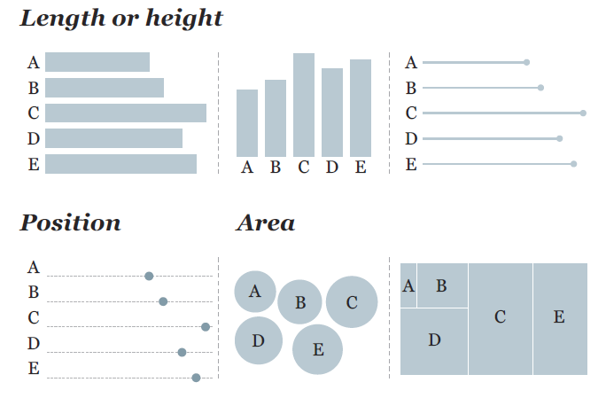
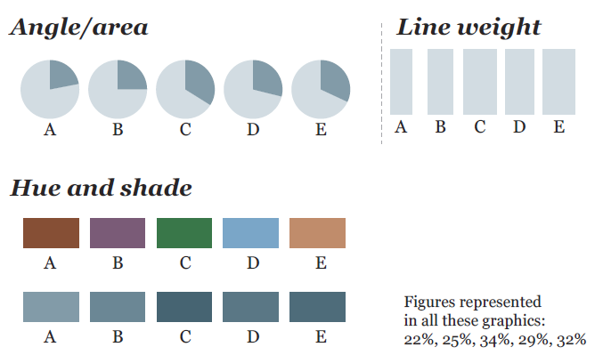
Visual Encodings
Transform numbers into a graphical representation
The Functional Art – Alberto Cairo

Slide 18
Big Numbers
Great to display simple information
Tips:
It is good practice to present a relative metric
Page Views:
5,567
Daily Average: 3,625

Slide 19
Tables
Conveys comparisons across categories
Tips:
Too big is less effective
 | Like chocolates | Do not like chocolates
Kids | 23 | 5
Grown Ups | 35 | 32

Slide 20
Bar Charts
Uses length to represent a measure
Compare different groups or categories
Track changes over time
Tips:
Sort based on something meaningful (e.g. length, alphabetical)
Start scale at 0
Horizontal, vertical and stacked bars are commonly used

Slide 21
Histograms
Represents the distribution of data
Tips:
Range of values must be binned
Can be normalized (sum of all frequencies equals 1)
Estimates the probability functions
It is a variation of a bar chart

Slide 22
Line Charts
Track changes over time
Allows for potential forecasting
Height and slope lets us see trends
Tips:
Ideal for continuous data
Time is represented in the x-axis
Do not use if x-axis is non-numeric

Slide 23
Scatter Plots
Displays relationship between two measures
Tips:
Best for continuous data
Do not use for qualitative data

Slide 24
Bubble Charts
Used for scatter plots with 3 variables
Tips:
Size causes confusion
4A
2A
A
2d
d
Notes:
These charts are not very popular given that it is hard to compare areas. For example if the small circle has a value of 1, what is the value of the bigger circle? (it could be 2 because the diameter is double or 4 because the area is 4 times.

Slide 25
Pie Charts
Compare parts of a whole
Tips:
All parts must add up to 100%
Best for categorical data
Order clockwise by size or any meaningful order
Hard to read when:
Components have similar size
More than 3 parts

Slide 26
Heat Maps
Use color to display trends or emphasize information

Slide 27
Presentation Types
Comparison
How do our sales compare to the last few years?
Composition
What percent of our users like football?
Relationship
How does the stock price change with the weather?
Distribution
What is the typical age of our customers?
http://labs.juiceanalytics.com/chartchooser/index.html

Slide 28
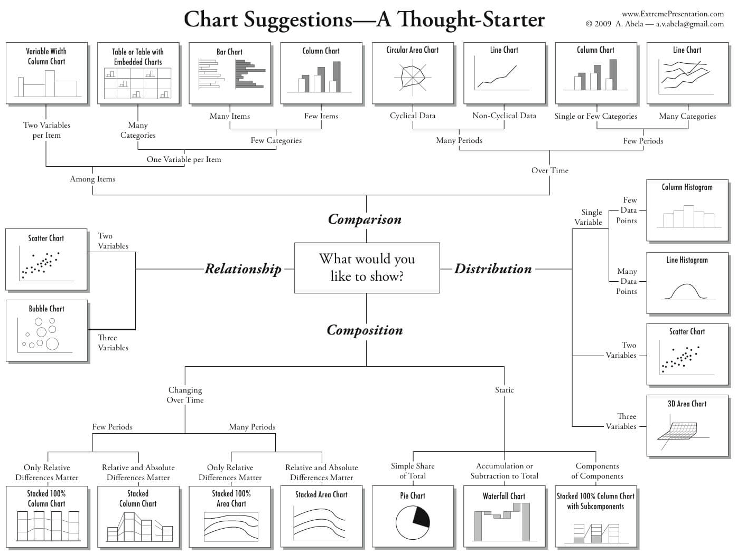
Presentation Types
https://extremepresentation.typepad.com/files/choosing-a-good-chart-09.pdf
Dr. Andrew Abela
Notes:
Most of the charts you will create are highlighted in blue

Slide 29
PROBLEM STATEMENT

Slide 30


Problem Statement
Notes:
A common problem is working in a team and having a great insight. You then ask the team to email you charts to put on a presentation for the key stakeholders.

Slide 31
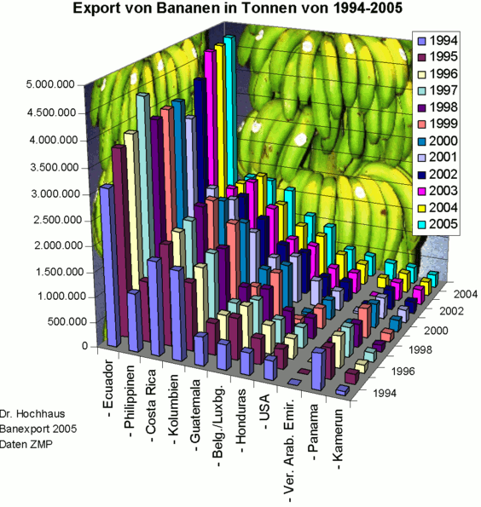
Problem Statement
Notes:
When you receive the charts that they sent, one of them looks like this.
What is the main conclusion of this chart? It’s hard to say. This is a data dump.

Slide 32
DESIGN

Slide 33

Don Norman - 1988
Notes:
Norman doors were named after Don Norman for labelling poor door design.

Slide 34
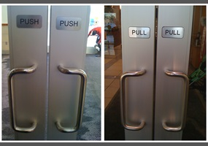
Norman Door
A door where the design tells you to do the opposite of what you’re actually supposed to do
A door that gives the wrong signal and needs a sign to correct it
Notes:
The image above is a Norman door.

Slide 35
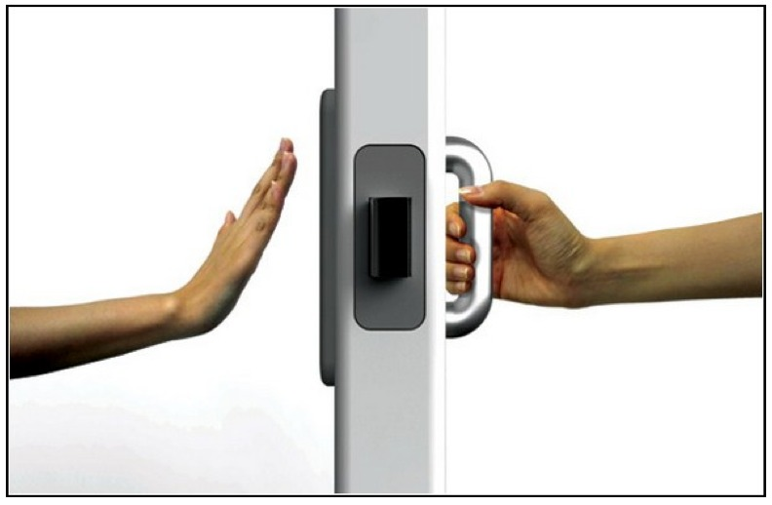
Discoverability
The ability to discover what operations one can do
Notes:
This door is better designed. The user can figure out how to make it work.

Slide 36
TEXT

Slide 37
Text Orientation
Vertical text orientation requires
mental effort!

Slide 38
Text Orientation
S
o
d
o
e
s
t
h
i
s
!
Vertical text orientation requires
mental effort!

Slide 39
Text Orientation
S
o
d
o
e
s
t
h
i
s
!
Vertical text orientation requires
mental effort!
Field of view
Horizontal text is easier to read!
Notes:
We read horizontally and our field of view is larger in the horizontal direction. Avoid vertical text.

Slide 40
Font Size
Just like Goldilocks!
Notes:
Find the right font size

Slide 41
COLOR

Slide 42



Color Palette
Max 5 colors
http://tools.medialab.sciences-po.fr/iwanthue/
http://colorbrewer2.org/#type=sequential&scheme=BuGn&n=3
http://www.color-hex.com/color-palettes/
https://coolors.co/
https://www.canva.com/color-palette/
Notes:
As a rule of thumb do not use more than 5 color on your palette

Slide 43
Color
Sequential
Diverging
Categorical
Highlight
Notes:
Colors are used in these four forms

Slide 44
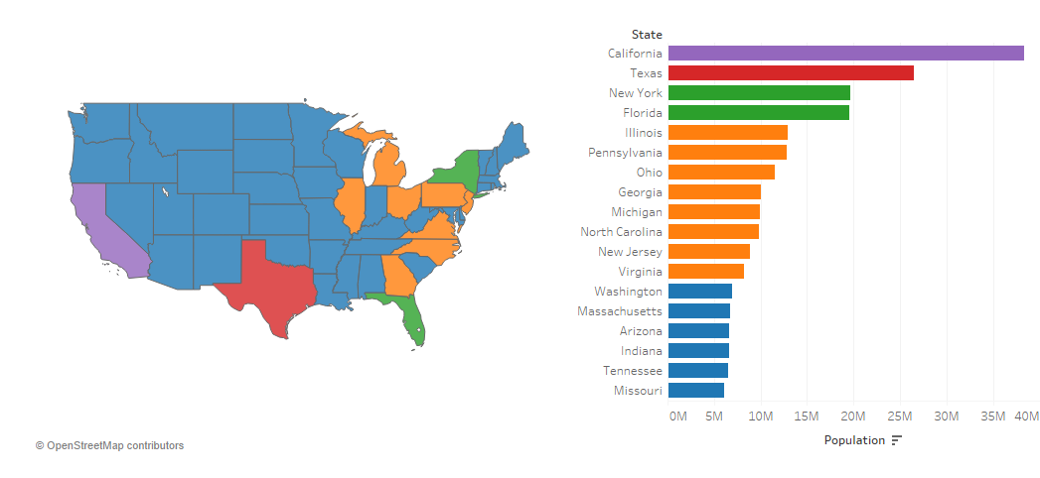
Color consistency across charts
Notes:
If you create multiple charts, make sure you use the same color scheme throughout

Slide 45
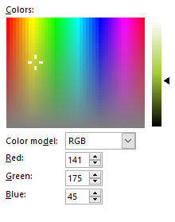
Color theory

Slide 46
RGB to grayscale
$$Grayscale=0.21×R+0.72×G+0.07×B$$
RGB Image
Grayscale Image
Notes:
Any color can be converted into grayscale using the equation above. The colors on the left will print in the same grayscale. A lot of your charts may be printed out in a B+W printer, so make sure the grayscale does not lose your color scheme.

Slide 47


RGB to grayscale
$$Grayscale=0.21×R+0.72×G+0.07×B$$
Notes:
What is the color of his shirt? This is an example of two colors that look similar in grayscale

Slide 48
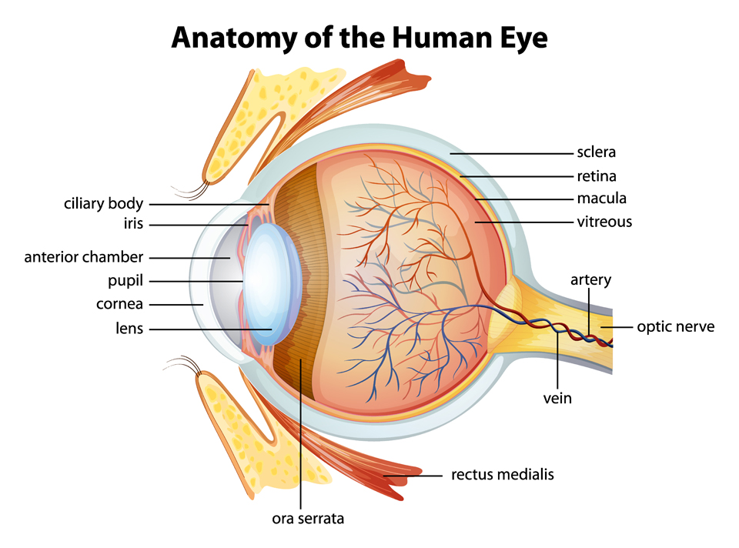
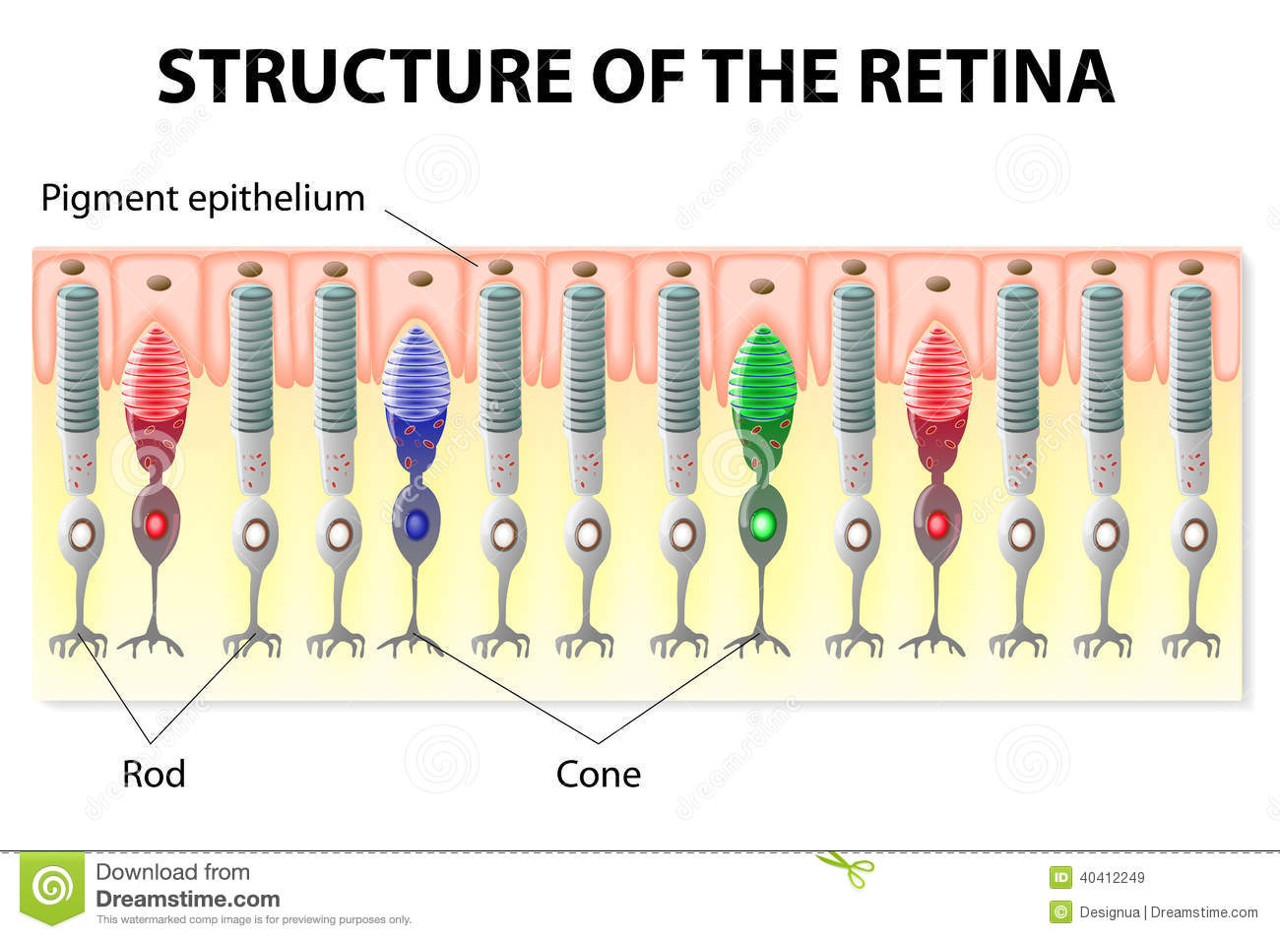
Anatomy of the human eye
Photoreceptors
Notes:
Rods don’t see color but are sensitive to low light. We use this to see in the dark (when we wake up in the middle of the night). Cones are for color.

Slide 49
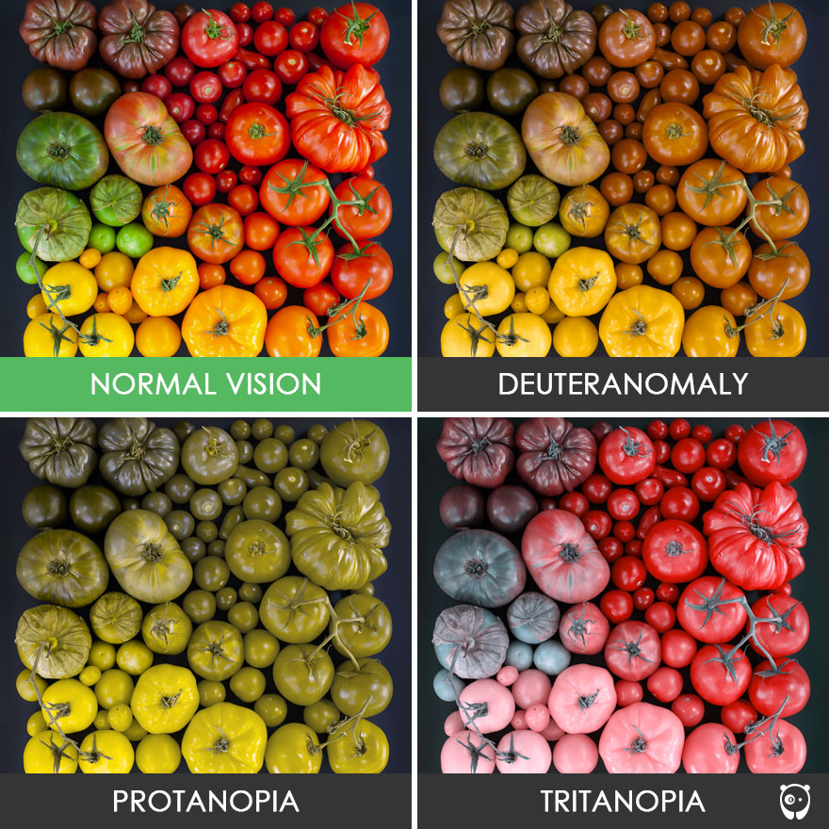

Color blindness
Lack of Green Cones
0.5% 8.0%
Lack of Red Cones
Lack of Blue Cones
Notes:
Color blindness is a lack of cones.

Slide 50
Color blindness
Instead of red and green
use blue and orange
Resources:
http://asada.tukusi.ne.jp/cvsimulator/e/
https://accessgarage.wordpress.com/2013/02/09/458/

Slide 51
HIGHLIGHT

Slide 52
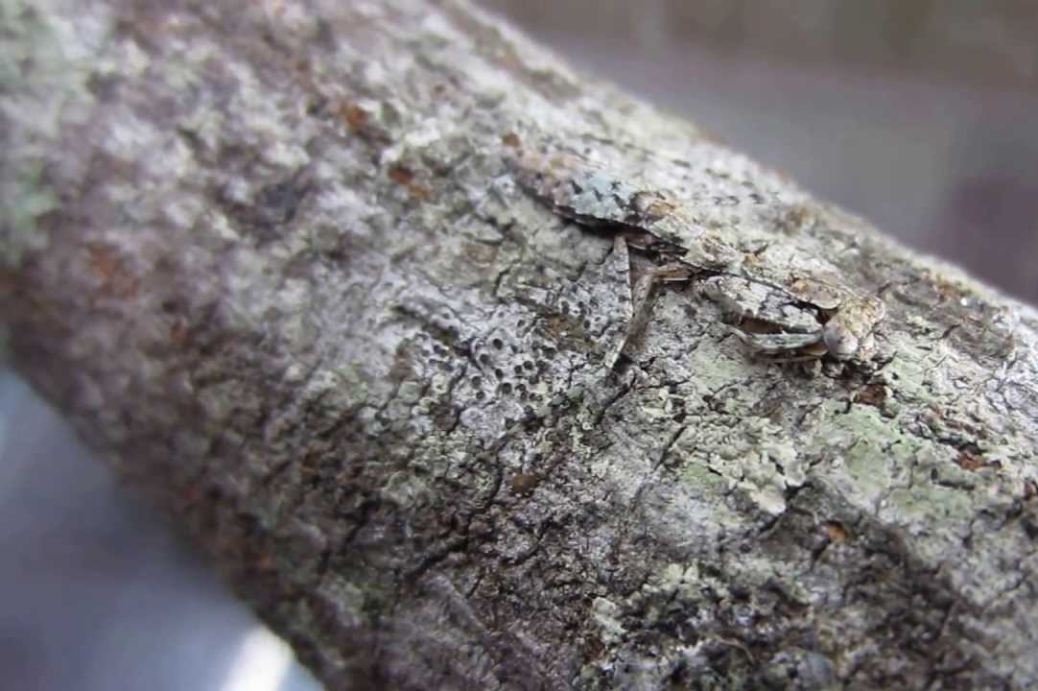
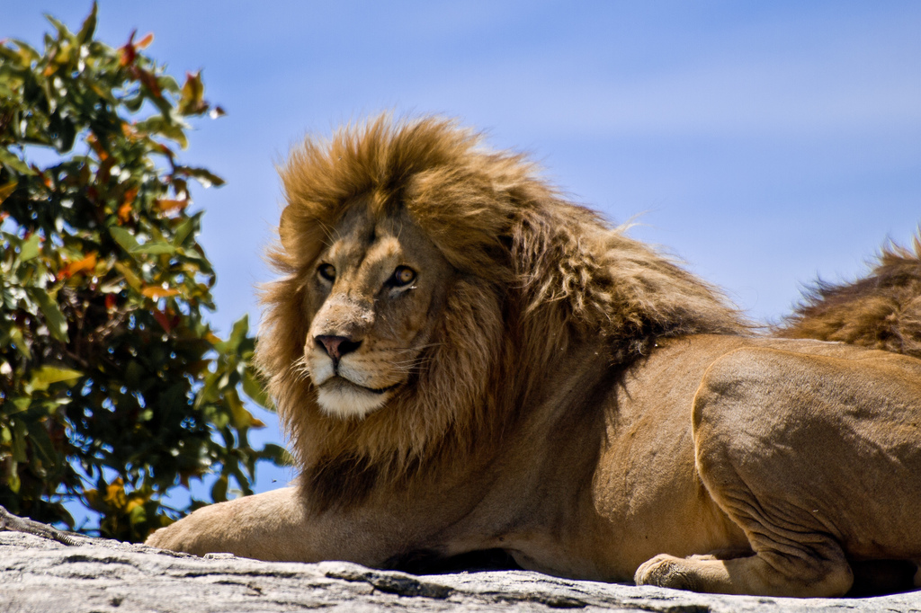
Discriminate background
Florida Bark Mantis
Notes:
We distinguish foreground and background well. Try to avoid the camouflage.

Slide 53
TEST: How many threes?
Notes:
Ask students to figure out how many 3’s are in the next image. It will take them some time.

Slide 54
How many three’s?
5498731840
4893128612
2634085106
1592059852
3854634876
Notes:
Now ask them again for the next slide.

Slide 55
How many three’s?
5498731840
4893128612
2634085106
1592059852
3854634876
Notes:
This task is much easier.

Slide 56
Balance background and foreground
ACVLSIGBSLWUHKAJSLHV
ACVLSIGBSLWUHKAJSLHV
ACVLSIGBSLWUHKAJSLHV
Notes:
Here we see that on the top, everything is on the background. In the middle, everything is on the foreground. The bottom has the right balance, which allows us to see the hidden message.

Slide 57
Pre-attentive attributes
Orientation
Width
Size
Shape
Color
Enclosure
Notes:
These are areas that our brain processes subconsciously before we think about it. We can use them to highlight things.

Slide 58
What is the main point?
Highlight your conclusion
Non-critical information should be removed or put in the background

Slide 59
Gridlines
Move to background or completely remove
Notes:
Unless you need gridlines, avoid having them.

Slide 60
Increase Data-Ink Ratio
Unnecessary:
Background color
Gridlines
“Above all else show the data”
Tufte - 1983

Slide 61

30 second rule
Notes:
If a third party can’t figure out your chart within 30 seconds, you have not done a good job

Slide 62
COMMON MISTAKES

Slide 63
What is the value of “C”?
Avoid 3D

Slide 64
Which is the biggest slice?
Avoid too many slices

Slide 65
Sometimes pie charts work well
2 or 3 slices

Slide 66
What is the conclusion?
Scale should start at 0

Slide 67
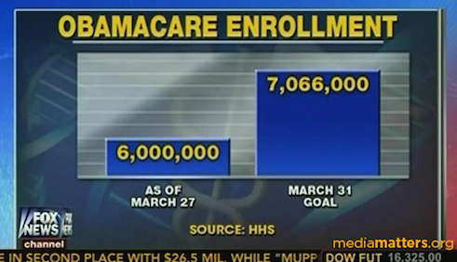
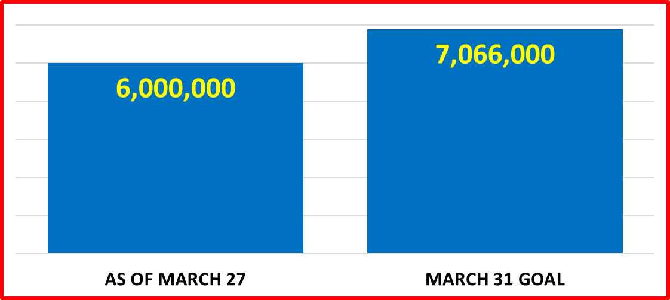
Example
Notes:
You would think that the difference between the bars is 3X, but when you look at the numbers it ends up being 14% difference

Slide 68
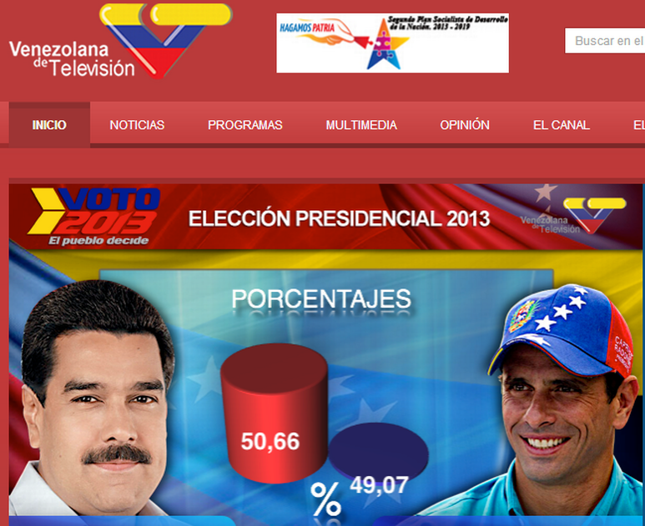
Example
Notes:
Left is Maduro running for reelection for Venezuela. On the right is the opposition candidate Enrique Capriles Radonski. What percent of the popular vote did each candidate get?

Slide 69
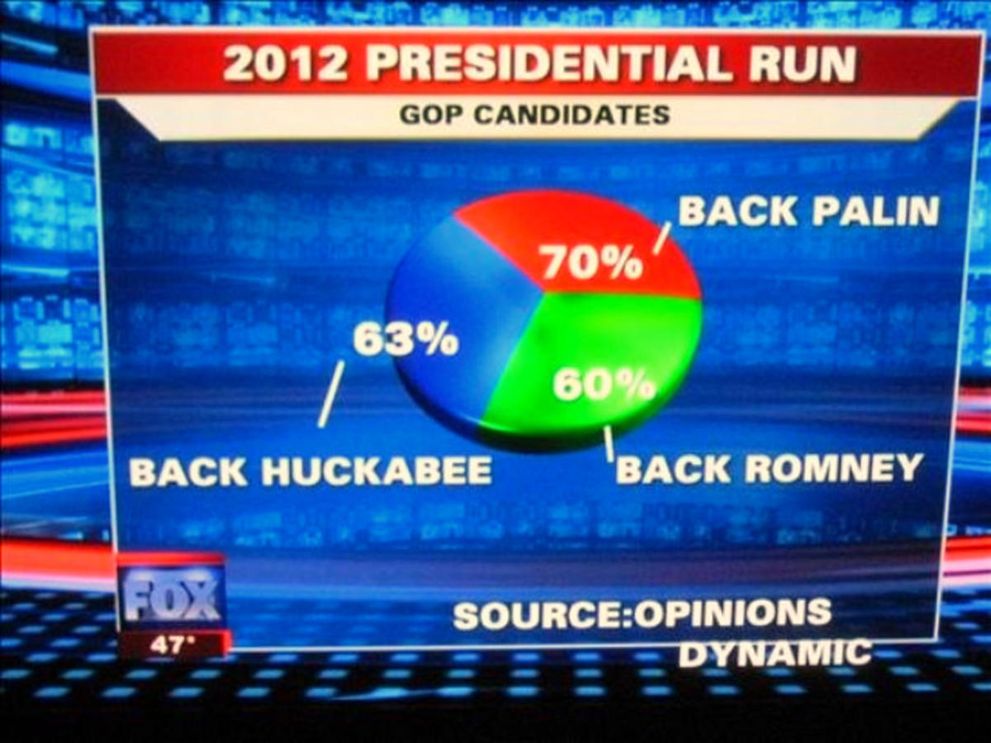
Example
Notes:
Pie adds to more than 100%

Slide 70
XKCD

Slide 71
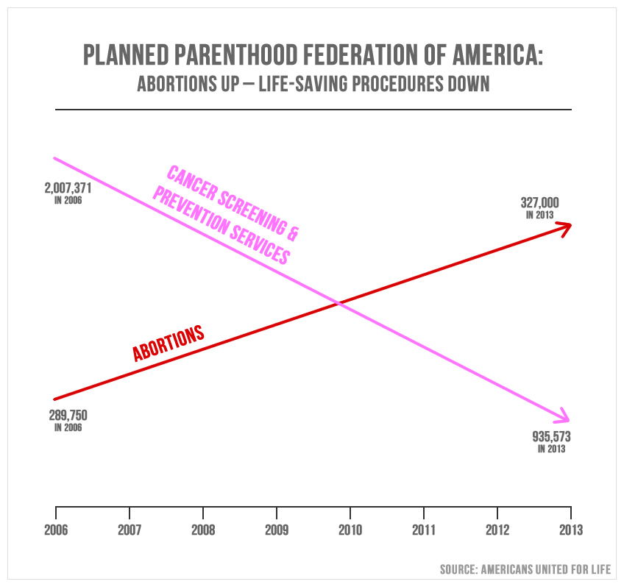
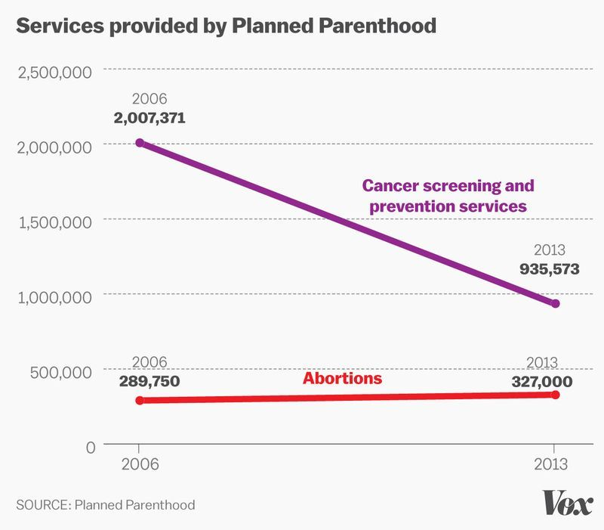
Example
Synchronize the
scale of both axis
Notes:
Left and right are same data but plotted with the same or different axis. The conclusions may be different depending on how you present the data.

Slide 72
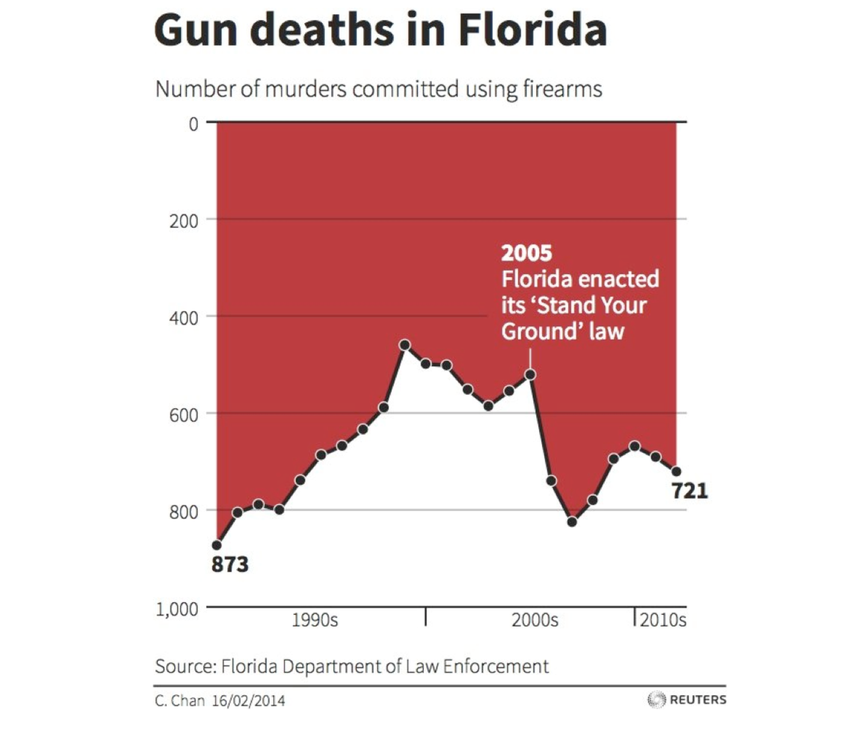
Example
Avoid inverted axis

Slide 73
EXAMPLES OF BAD VISUALIZATIONS

Slide 74
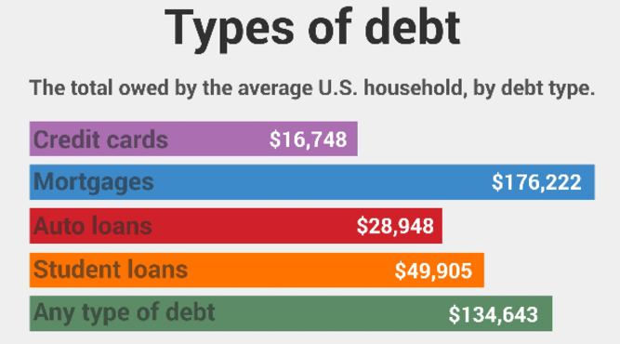
What is wrong with this visual?
Bar length
Colors

Slide 75
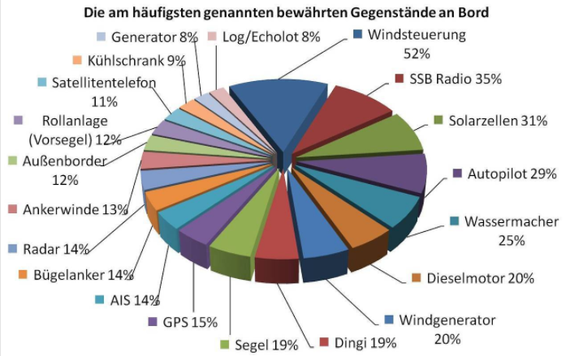
What is wrong with this visual?
3D
Too many slices
>100%

Slide 76
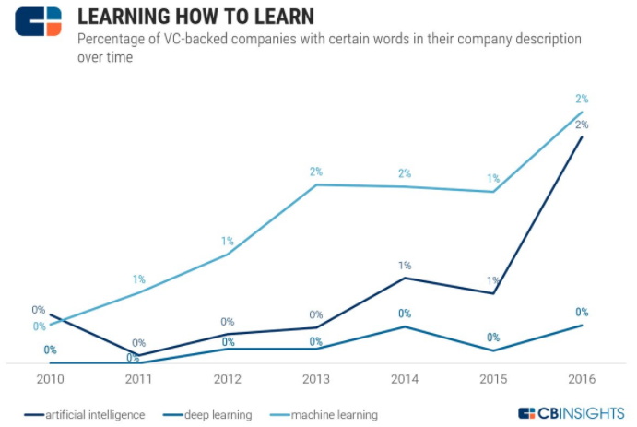
What is wrong with this visual?
Decimals

Slide 77
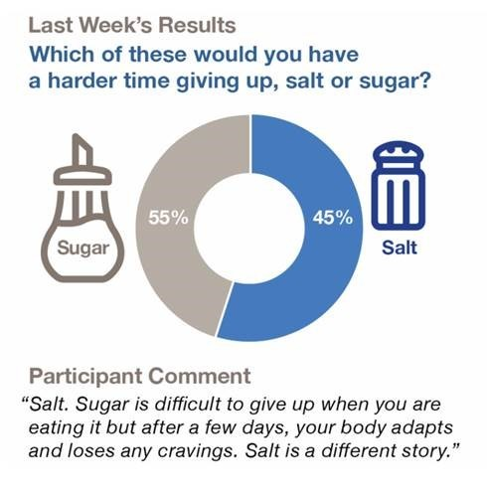
What is wrong with this visual?
Slice size

Slide 78
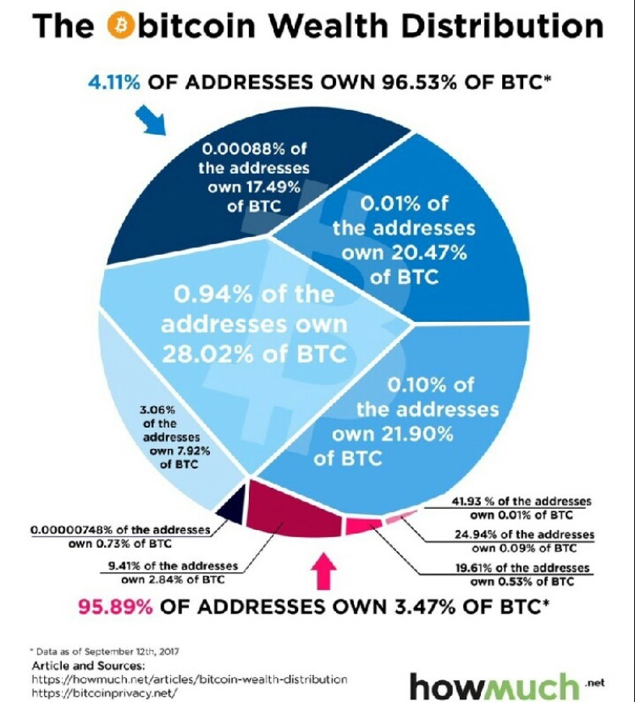
What is wrong with this visual?
How do you read?

Slide 79
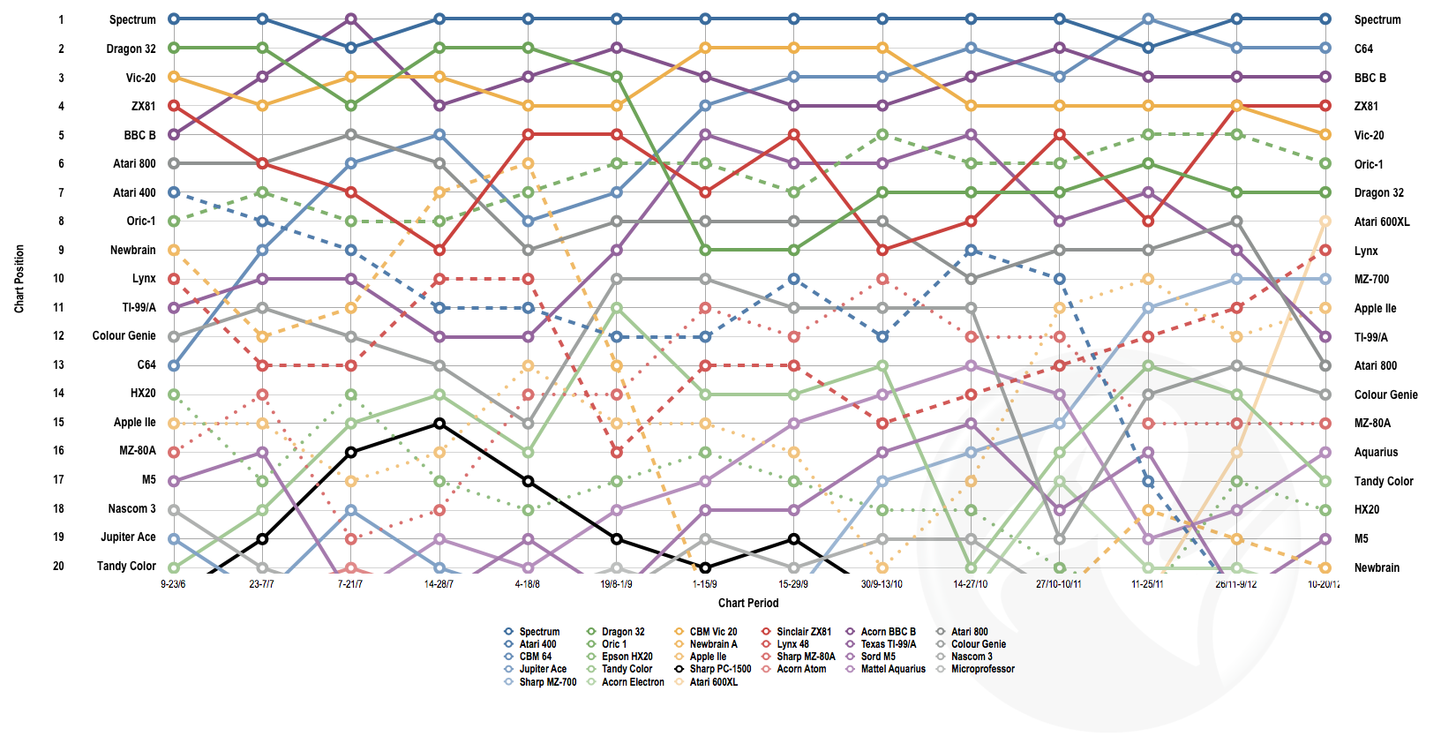
What is the conclusion?
Notes:
What is the goal of this chart, what are they trying to convey?

Slide 80
SIMPLIFY YOUR VISUALIZATIONS

Slide 81


The goal of a good visualization
CHAOS
ORDER

Slide 82
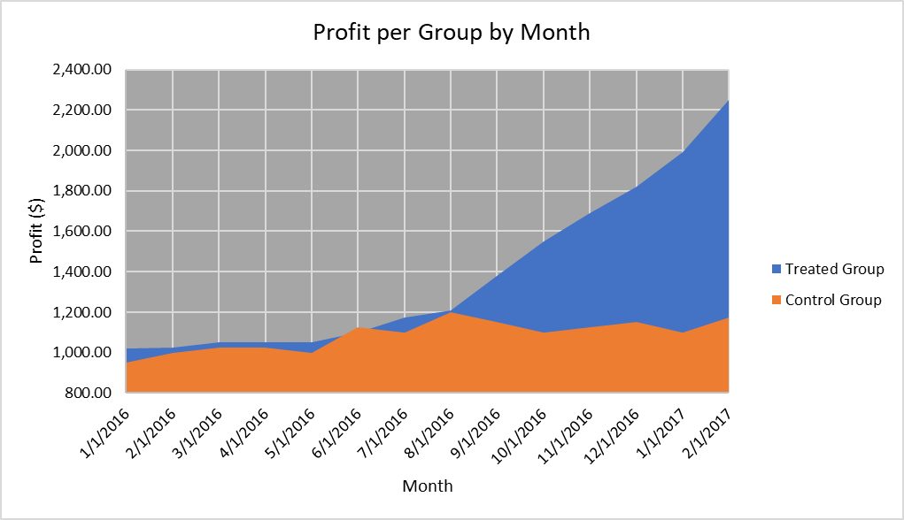
Example
Use line chart!
Notes:
How can this chart be improved? Have students brainstorm and show the suggestions.

Slide 83
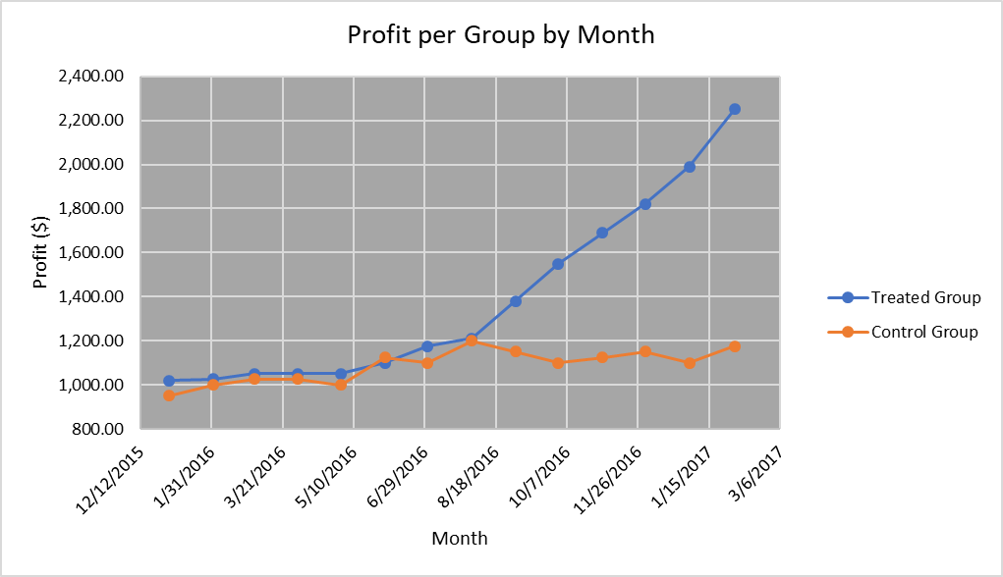
Example
Remove background color!

Slide 84
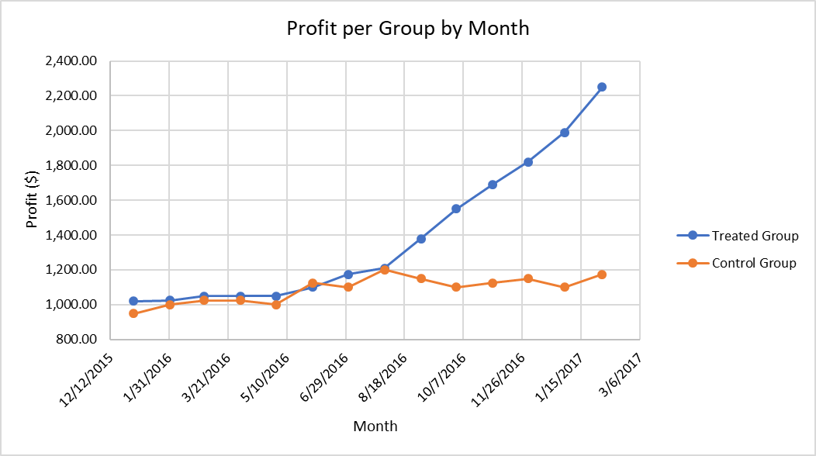
Example
Start axis at 0!

Slide 85
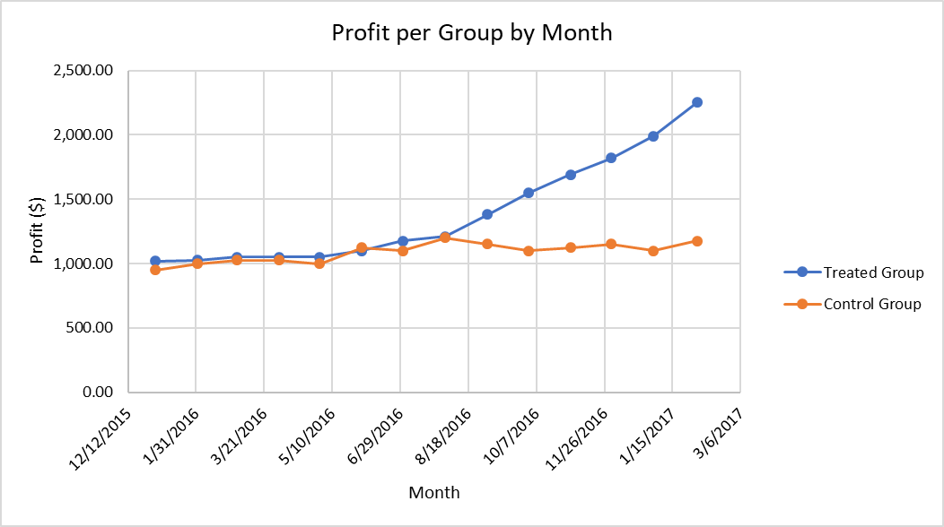
Example
Decimal points!

Slide 86
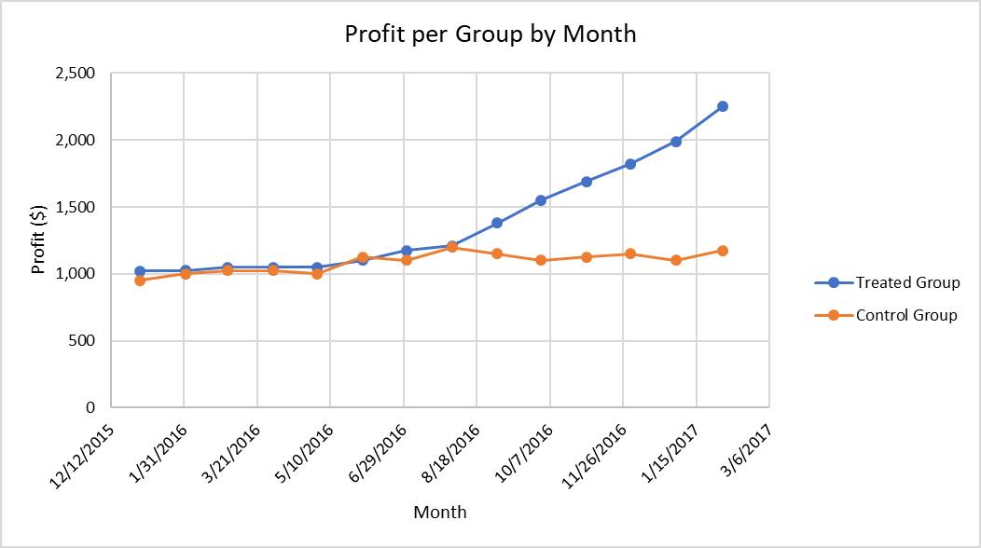
Example
Vertical “Profit” label!

Slide 87
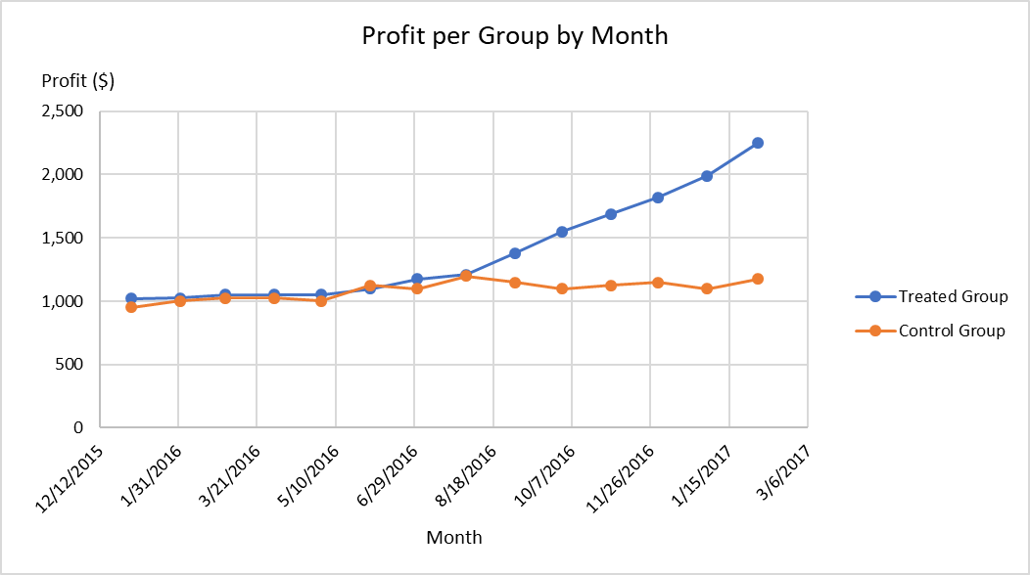
Example
Diagonal x-axis!

Slide 88
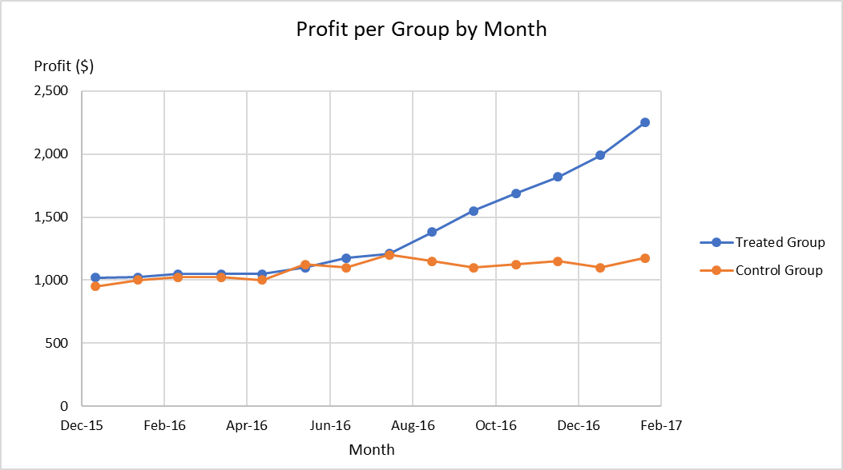
Example
X-Label left justified!

Slide 89
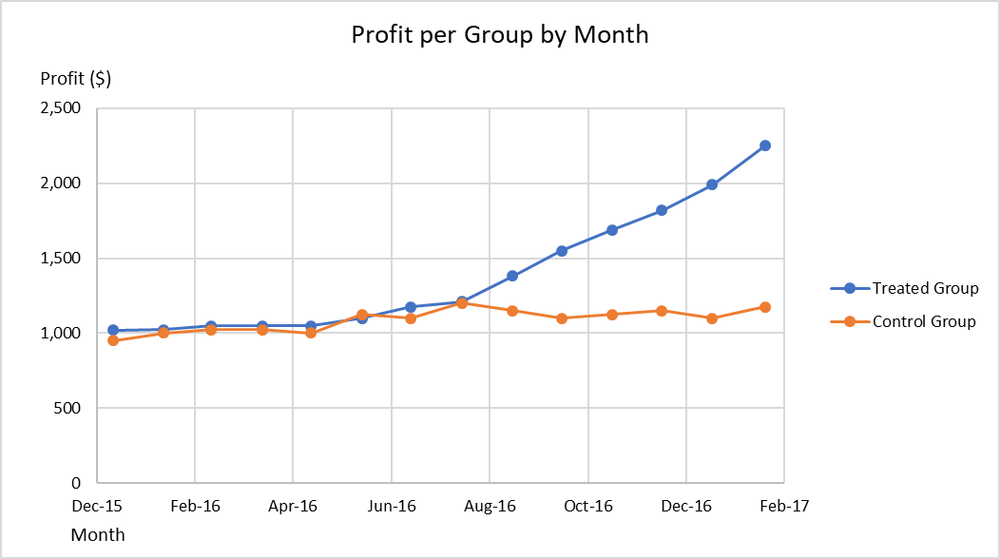
Example
Gridlines!

Slide 90

Example
Color and dots!

Slide 91
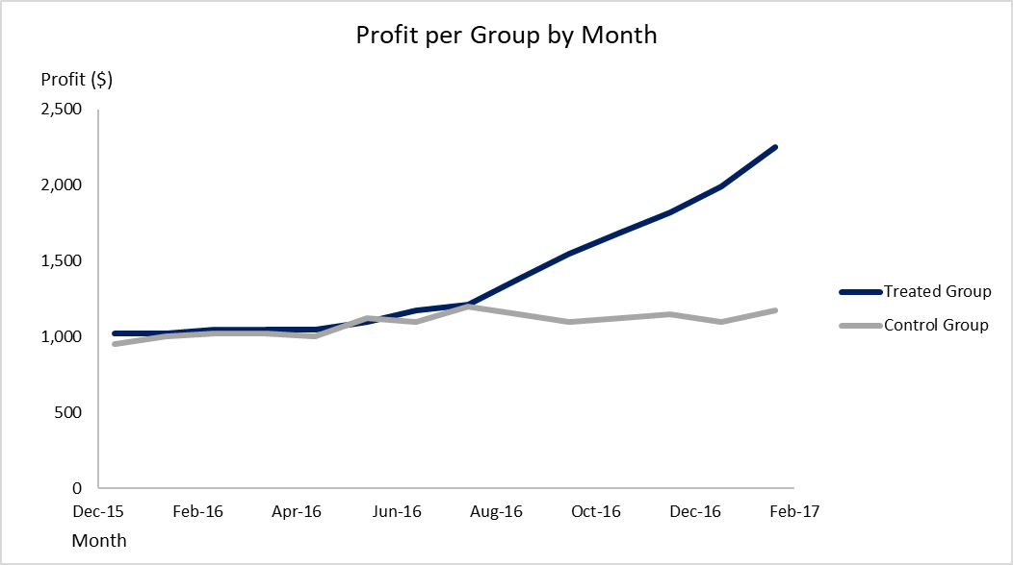
Example
Legend, proximity and space

Slide 92
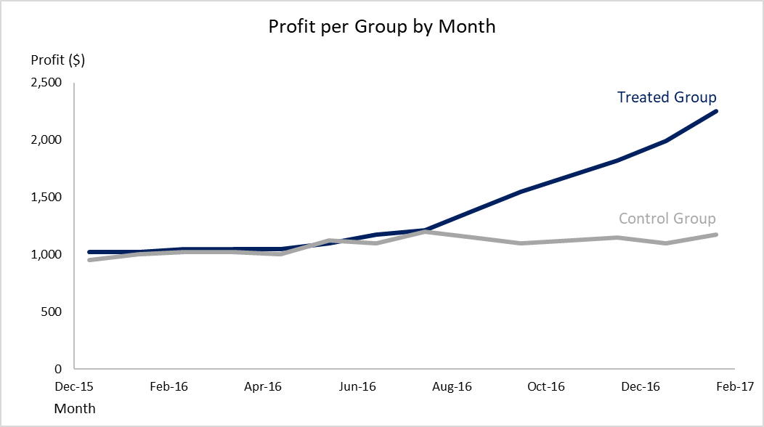
Example
Axis background

Slide 93

Example
Descriptive title and left!

Slide 94
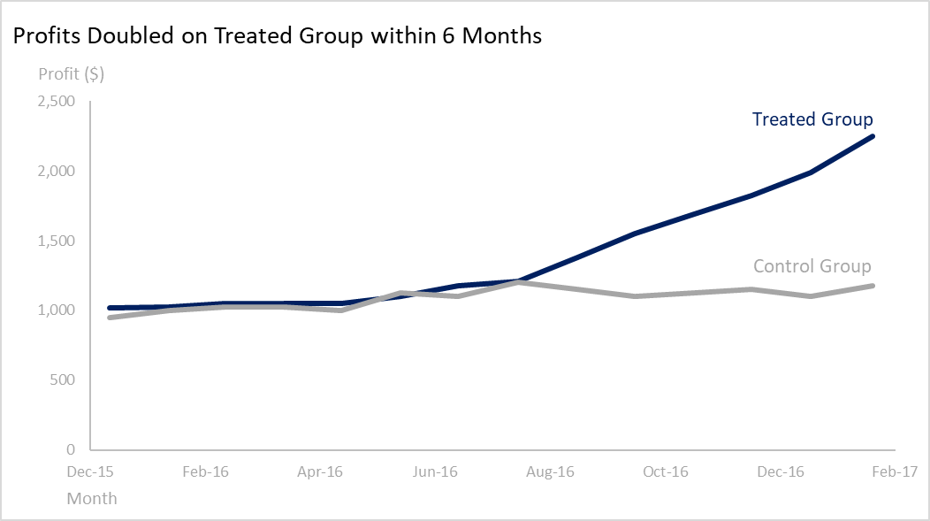
Example
Highlight!

Slide 95
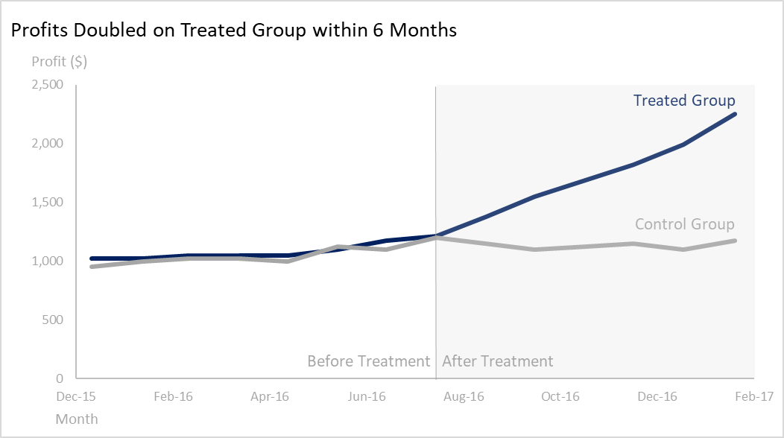
Example
Box!

Slide 96
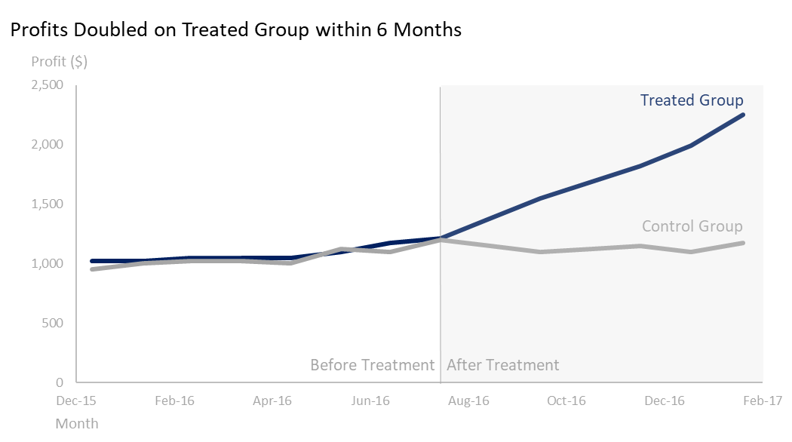
Example

Slide 97
Example

Slide 98
Grayscale

Slide 99
Summary
Charts should be effective, easy to interpret and understand
Use highlight to draw attention
Gridlines only if necessary
Charts
Avoid 3D
Avoid Pie Charts with too many slices
Text
Horizontal
Size easy to read
Color
Max 5 colors
Consistency across charts
Be mindful of:
Grayscale
Color Blindness

Slide 100
THANK YOU!

